Slide 1

Verizon
Catch-up
Presentation
Presented by
Team 3

Slide 2






Meet Our Team
Hongxuan Zhao
Research Analyst
Wisdom Chen
Data Scientist
Rita Cui
Data Analyst
Jessy Hu
Business Analyst
Boya Zeng
Business Intelligence Analyst
Colleen Jung
Data Scientist

Slide 3
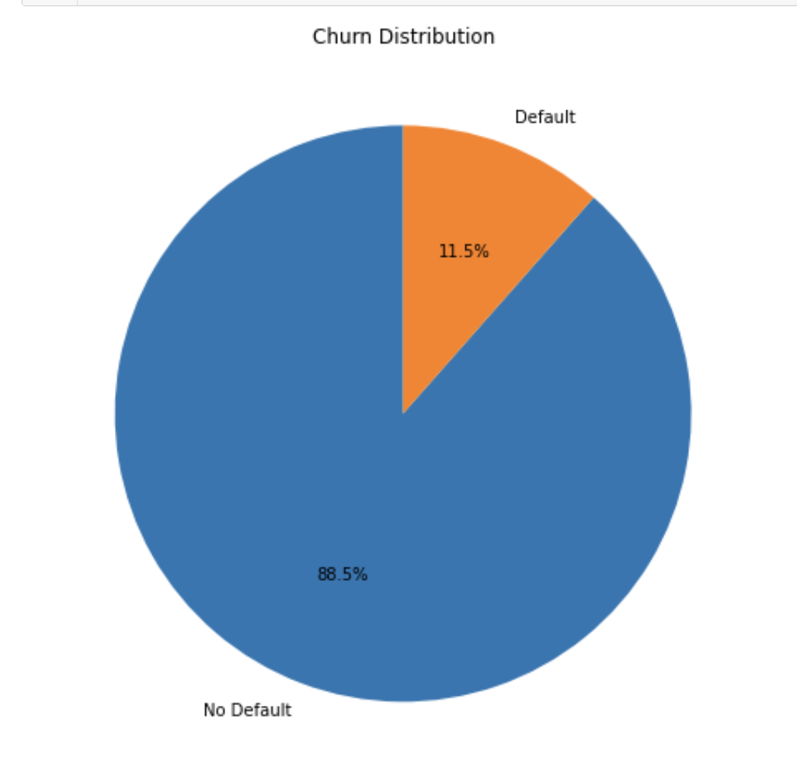
Problem Statement
Challenge: To predict customer defaults to mitigate financial risks associated with phone contracts.
Objective: Build a predictive model for in-store use, aiding the approval or rejection of customer applications.
Business Impact: Reducing defaults directly contributes to profit preservation and customer targeting efficiency.
Notes:
Verizon needs a predictive tool to identify which customers are likely to default on their phone contract payments, aiming to reduce financial losses and improve decision-making during the contract approval process

Slide 4


Current Business Value
Current Losses:
$92,000,000
Current Net Profits
$177,000,000

Slide 5
01
Recap of Data

Slide 6
Columns & Features
Price: Total cost for buying phone
Downpmt: Amount paid upfront
Monthdue: Total number of months after which remaining amount is due
Payment_left: amount due after downpayment
Monthly_payment: amount to be paid every month
Pmttype: Different payment options (1: Credit payments, 5: Cash Payments, 4: Debit payments, 3: Store gift card)
Credit_score
Gender: (1:Male, 2:Female)
Default: (0: Does not default, 1 defaults)

Slide 7
02
Methodology Selection

Slide 8
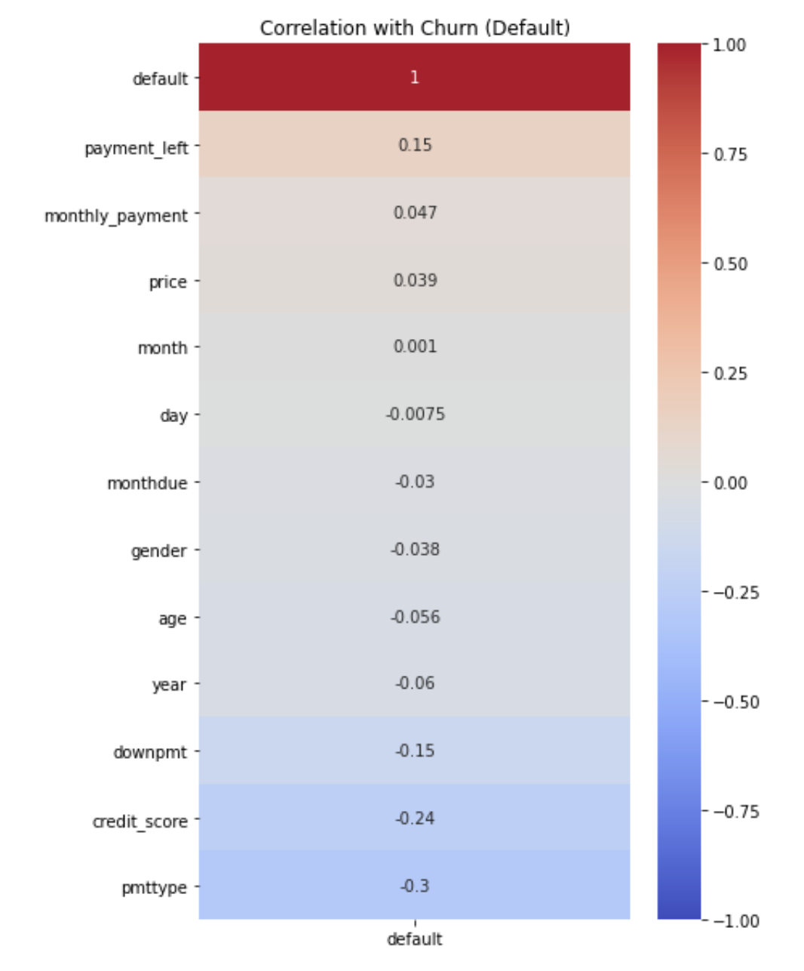
Input Variables
Remove time-related variables
Year
Month
Day
Not to build the times series model

Slide 9
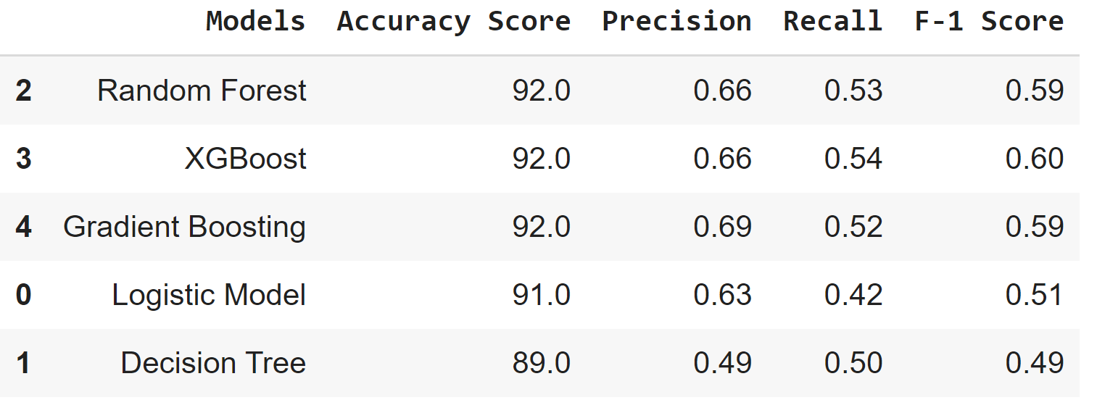
Model Comparison
Accuracy
Random Forest = XGBoost = Gradient Boosting
Precision
Identified defaulters that were actual defaulters
Gradient Boosting > Random Forest = XGBoost
Gradient
Boosting is better

Slide 10
03
Estimate of
Business Value

Slide 11
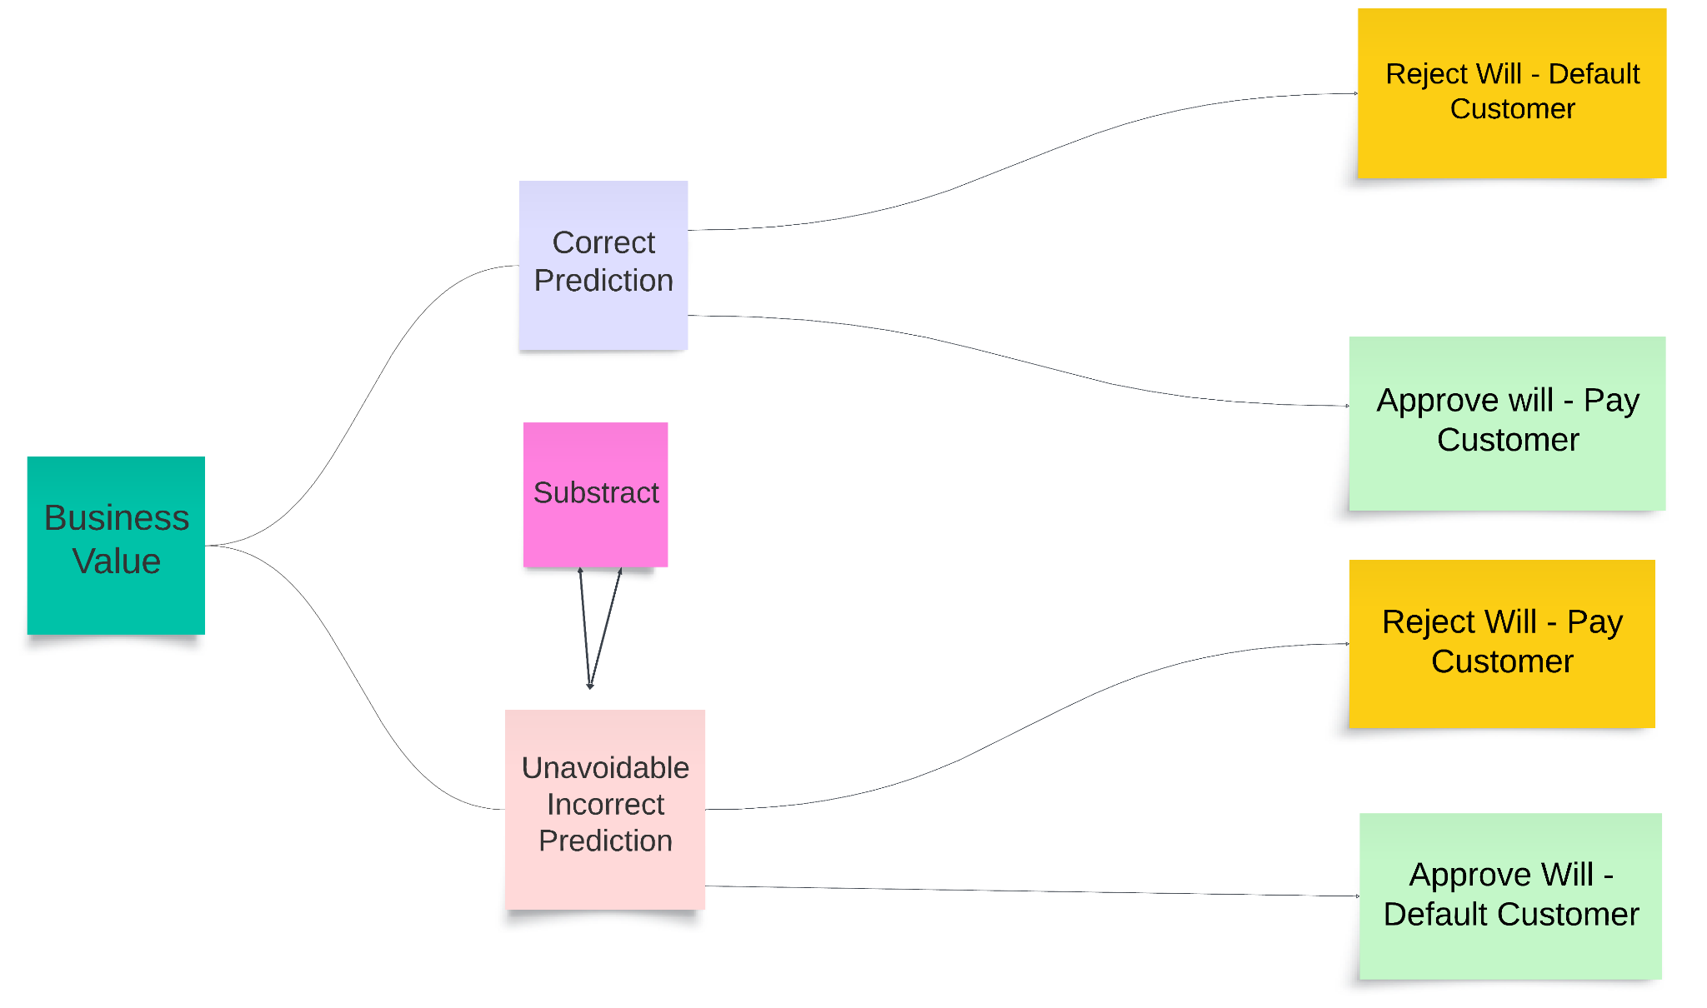
Business Value Composition
Avoidable Loss
Potential Profit
Unavoidable Loss
Missed Profit
Avoided Loss + Potential Profit - Unavoidable Loss - Missed Profit

Slide 12
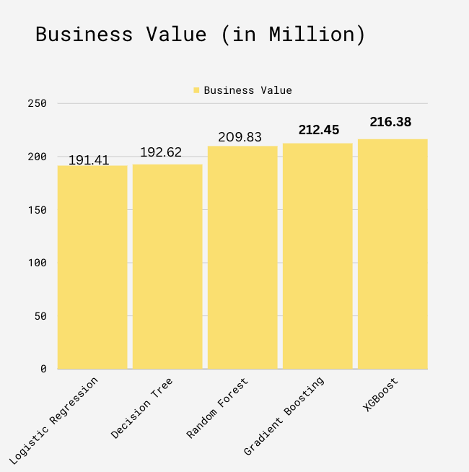

Business Value
XGBoost
Highest business values
But, model not performed well (overfitting)
Not a stable model
Gradient Boosting
Less business values than XGboost
Better model performance
Notes:
before we were thinking choose gradient boosting rather than XGboost because of better model performance (XGboost have overfitting problem). Even though the business value of XGboost is higher than gradient boosting, we could still explain it. below are some reasons we should not use XGboost
-If XGBoost is overfitting, it might have learned the training data too well, including the noise, which means it may not perform as well on unseen data. Overfitting is a significant issue because the primary purpose of a predictive model is to perform well on new, unseen data, not just the data it was trained on
- Overfitted models often have less stable performance over time as the patterns in the data change. If the characteristics of customers or economic conditions change, the overfitted XGBoost might not adapt well, whereas the Gradient Boosting model might be more robust to such changes.
- The calculated business value assumes that the model will continue to perform as it has on the evaluation data. If the XGBoost model is overfitting, its true business value on future data may be lower than estimate
all in all, we should choose gradient boosting over XGboost, while the immediate business value calculation suggests that XGBoost is superior, the potential lack of generalization due to overfitting is a serious concern

Slide 13
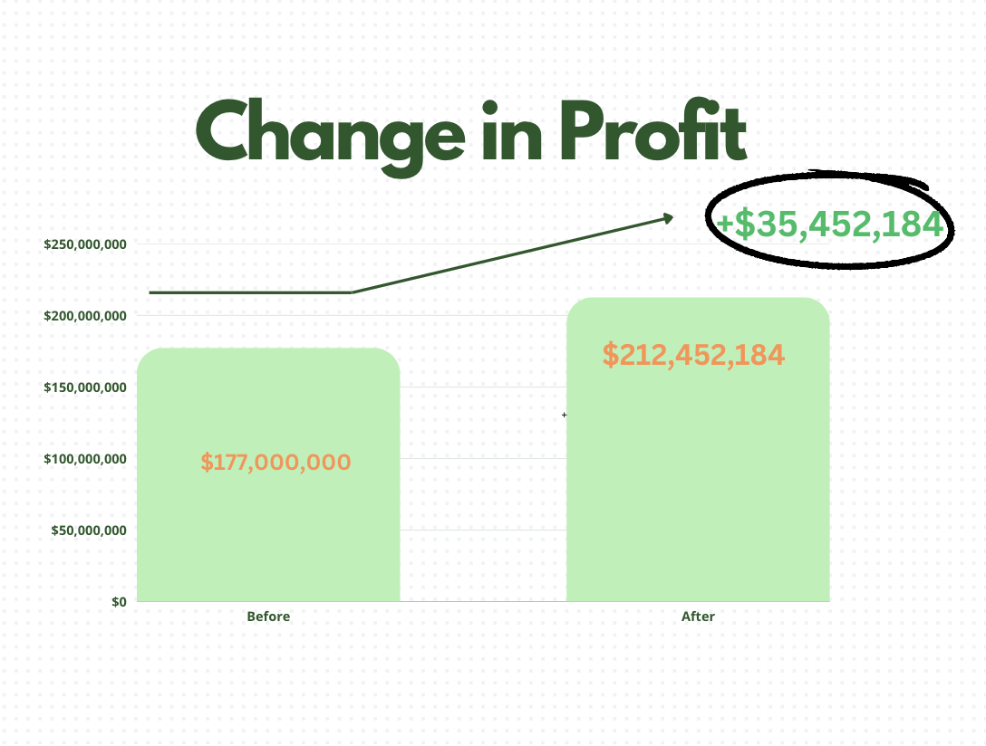
Net Profit Increase
Before:
$177 M
After:
$212 M
Change:
~ $40 M

Slide 14
Thank you

Slide 15
Appendix

Slide 16
Current Business Value
Current losses:
800,000 approved applicants * 11.5% default rate * $1,000 loss per default
$92,000,000
Current profits
(800,000 approved applicants - current losses in number of customers) * $250 profit per paying customer = (800,000 - 92,000) * $250
$177,000,000

Slide 17
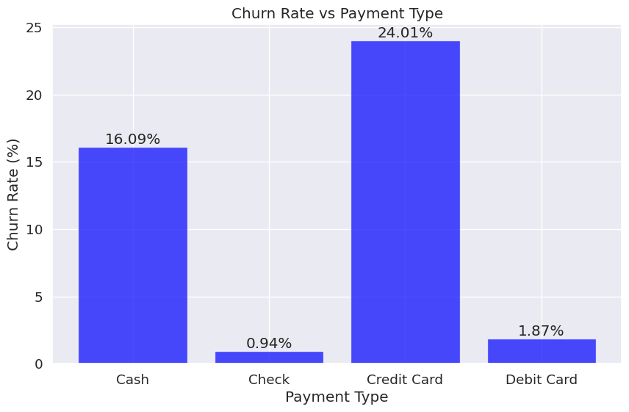
Churn Rate vs. Payment Type
Customers using a credit card has the highest churn rate stands for 24.01%
Indicates a pattern that direct bank-related payment methods(check & debit card) have lower churn rate than direct cash or credit card options

Slide 18
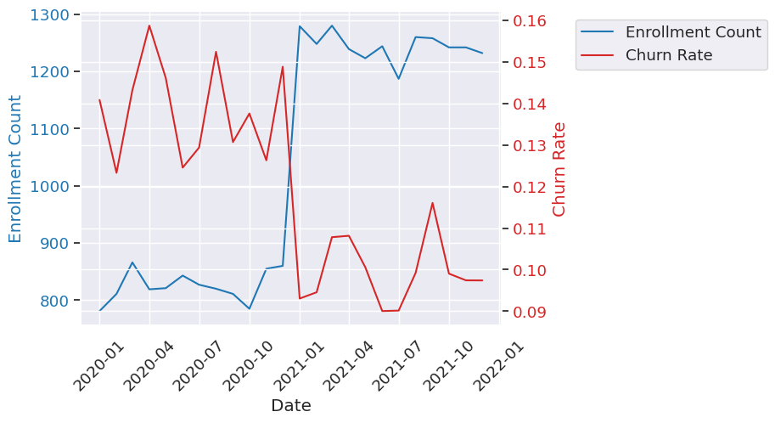
Churn Rate vs. Enrollment Count
Shows that higher enrollment counts are generally associated with lower churn rate

Slide 19
Calculation Formula
Benefit=Avoided Loss + Potential Profit - Unavoidable Loss - Missed Profit
=(TP×Loss per Default)+(TN×Profit per Paying Customer)−(FP×Profit per Paying Customer)−(FN×Loss per Default)
Model could not be 100% accurate on prediction
Loss per Default -> $1000
Profit per Paying Customer -> $250
Correct Prediction
Reject will-default customer
Approve will-pay customer
Incorrect prediction
Reject will-pay customer
Approve will-default customer

Slide 20
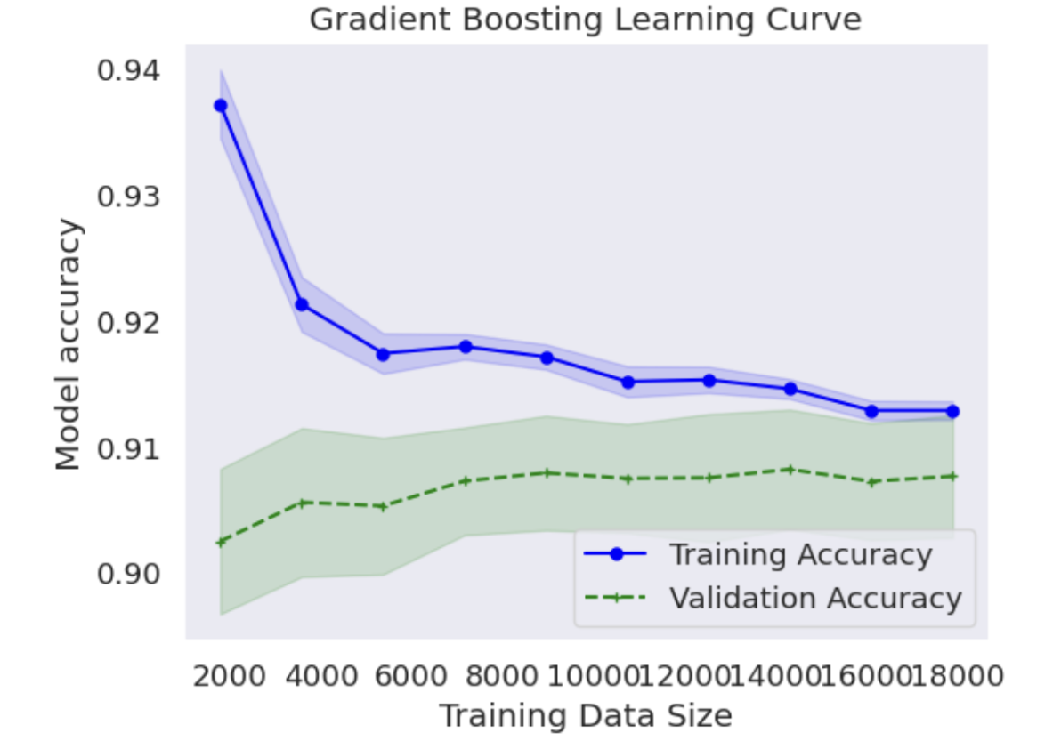
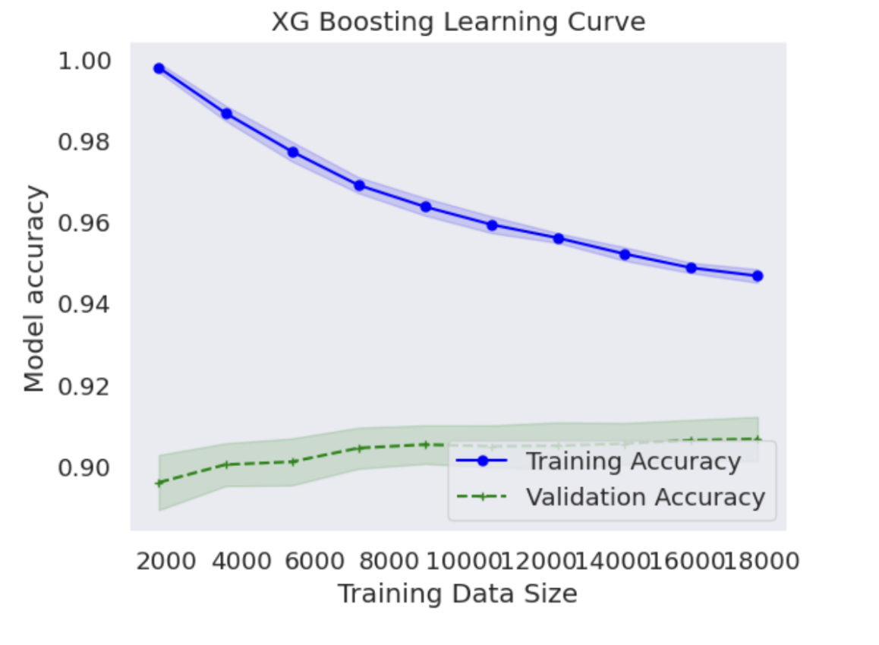
Gradient Boosting v.s XGBoost
Two Curve
Closer is Better
Gradient Boosting
is better

Slide 21
Implications of Potential Strategy
Further improve the model
Gradient Boost model can be improved to classify the customers into multiple classes based on their credit and risk of default
Tailor the payment plan for specific customers
For customers identified as high risk, Verizon may consider reaching out to provide tailored payment plans instead of directly rejecting them.
Regular feedback
Construct a feedback loop to regularly refine the model

